Slide 1
Choice Words 2019 Grants Conference

Slide 2
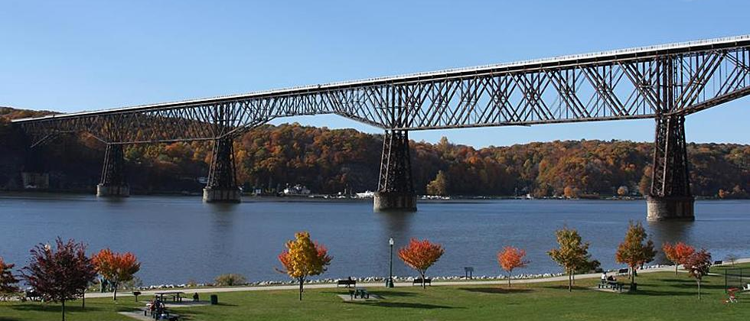
2019 Grants Conference
Choice Words client Walkway Over the Hudson
Wednesday, January 9th, 2019
Mount Saint Mary College
Presented by Choice Words LLC

Slide 3
Choice Words, LLC
Grant Writing | Public Relations | Strategic Communications
Choice Words has secured $68 million in grant awards for its clients since 2010. We help businesses, municipalities, government entities, and non-profit organizations in the Hudson Valley and beyond meet their funding goals.

Slide 4
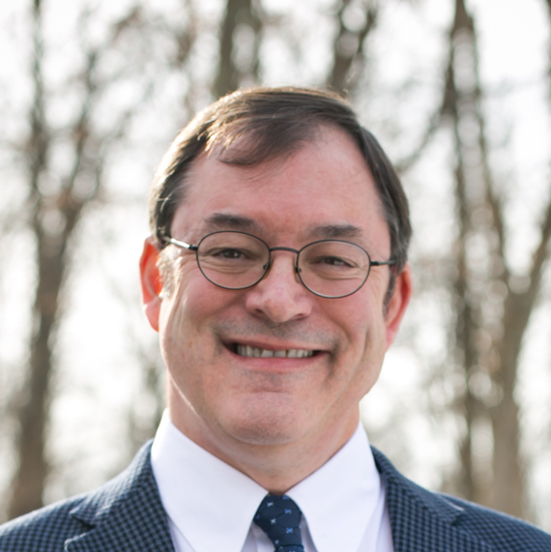
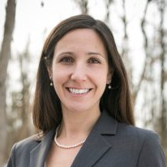
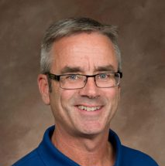
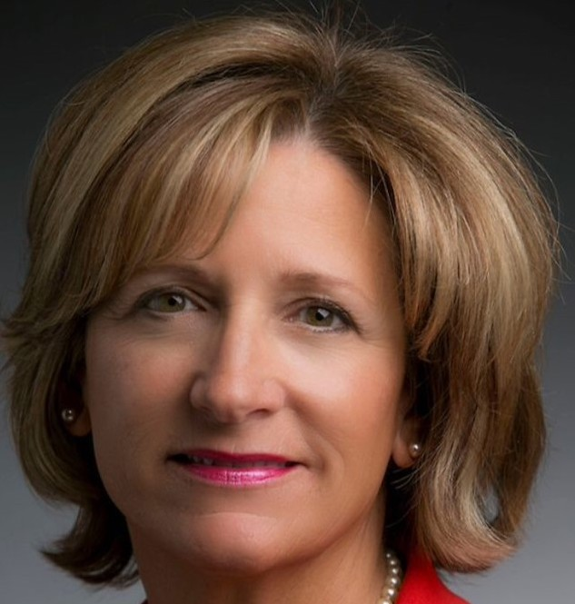
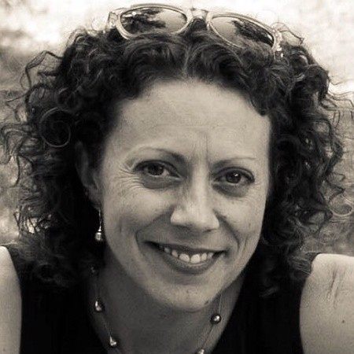
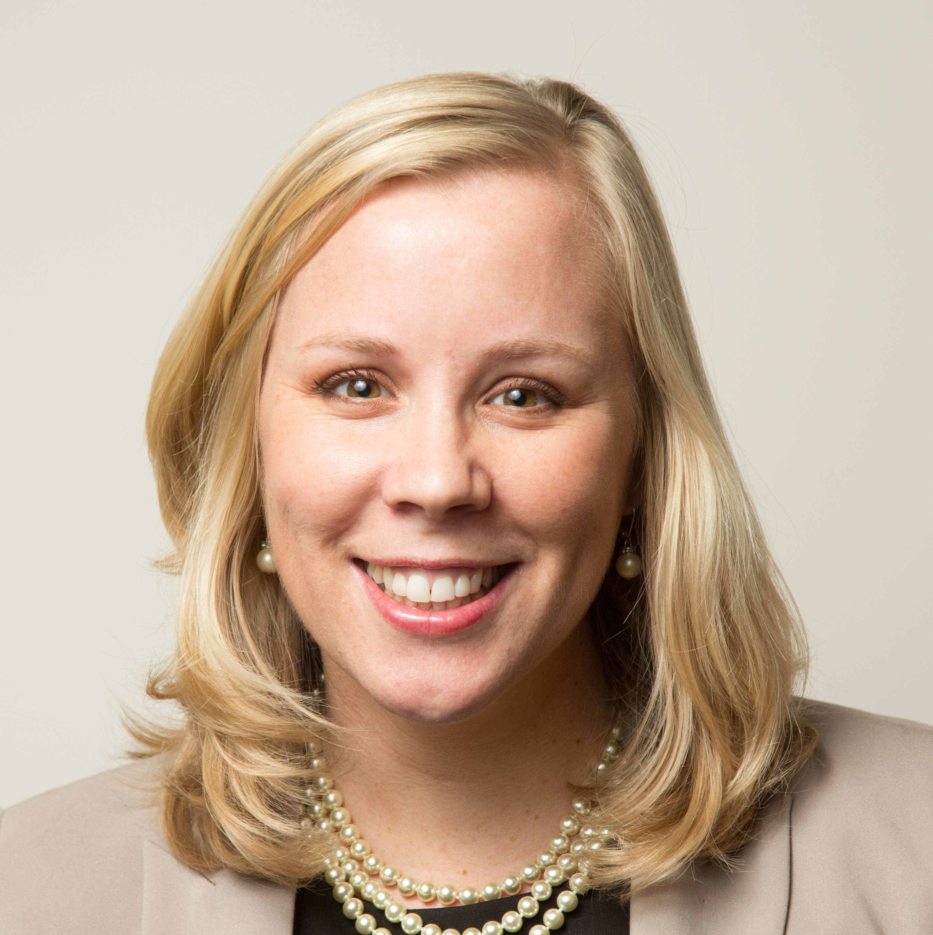
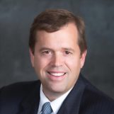
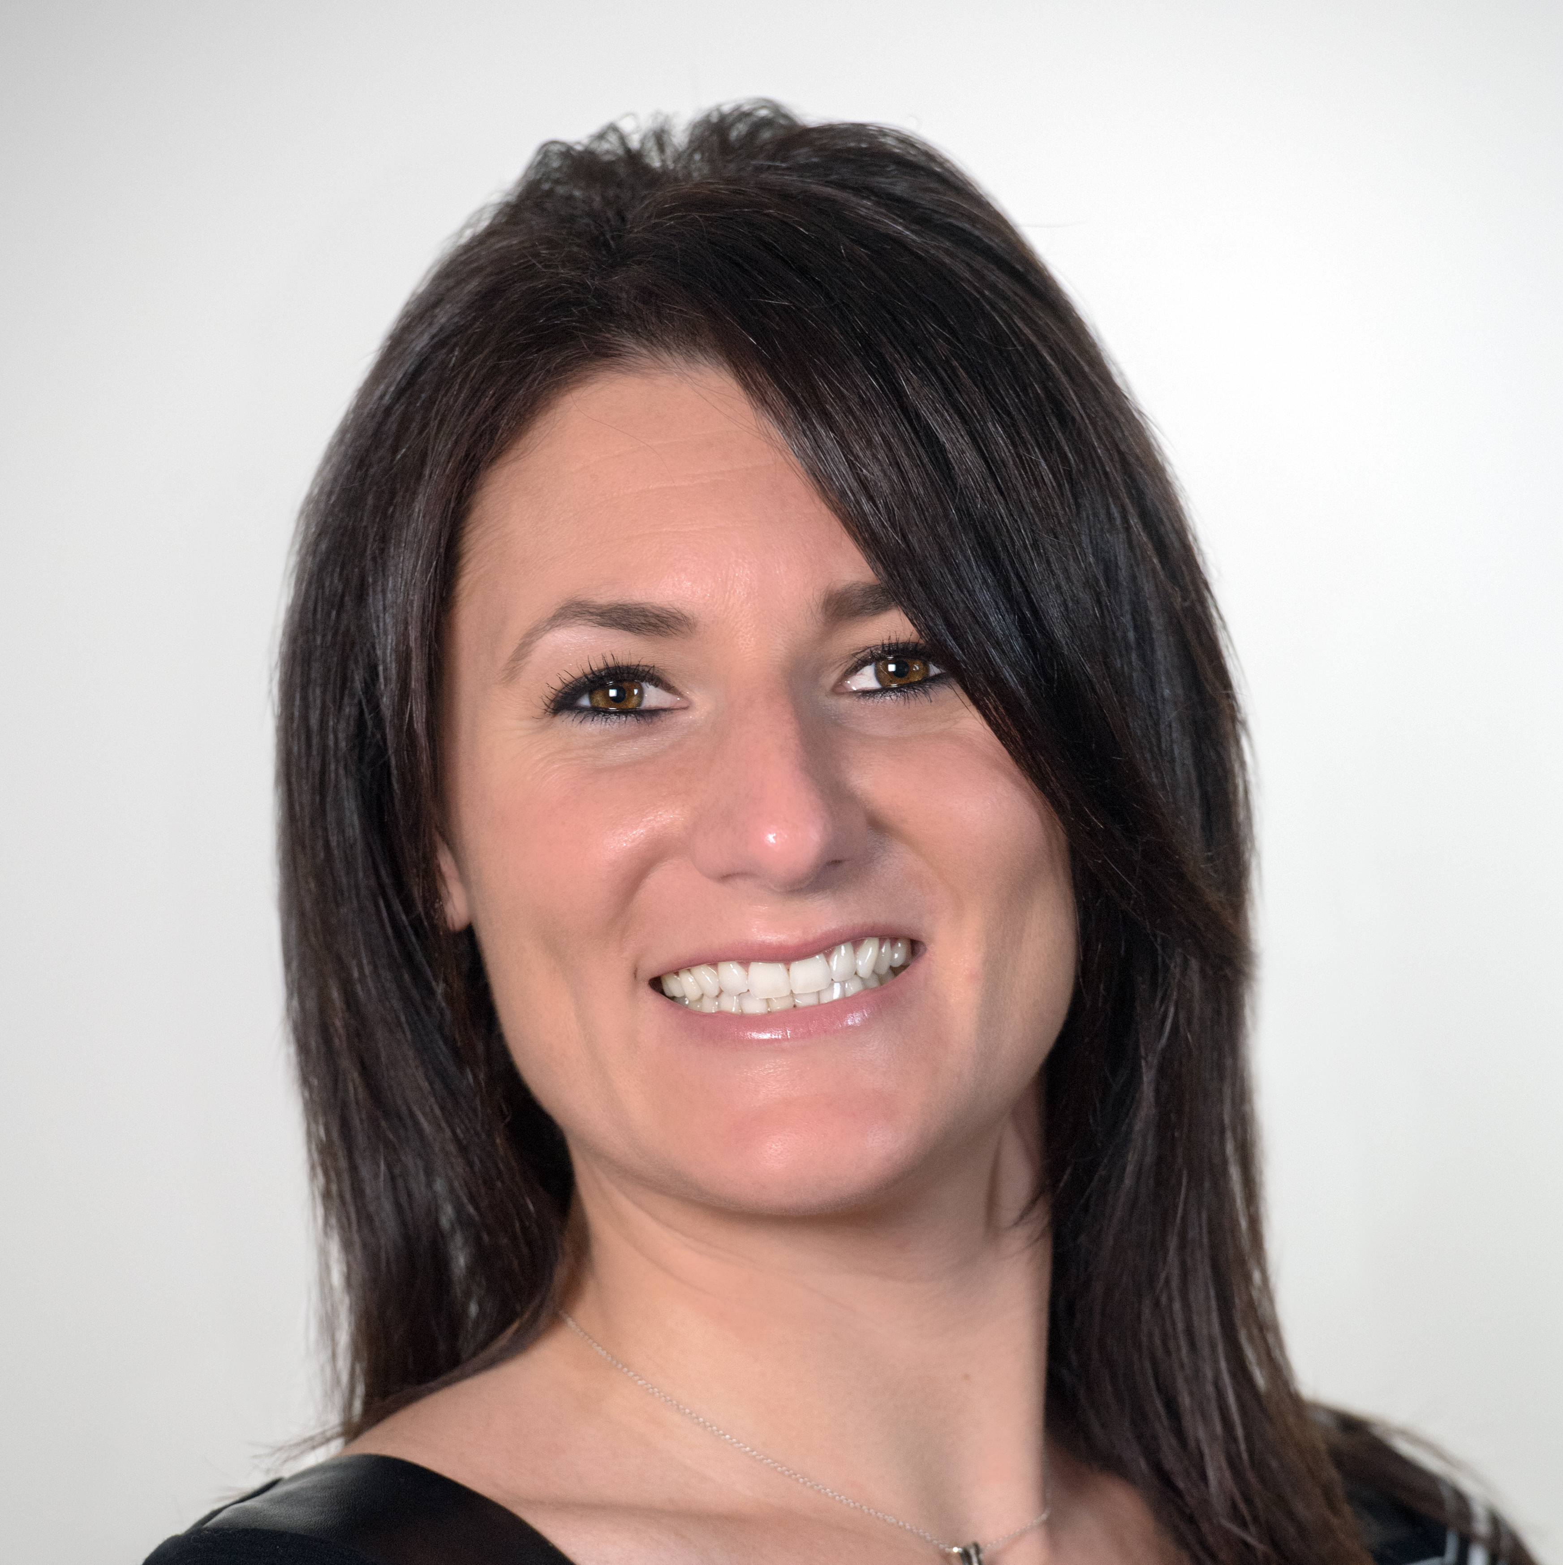
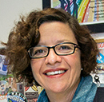
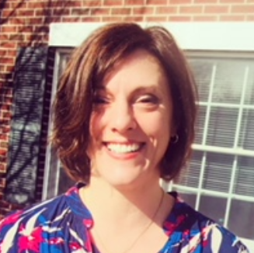
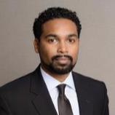
Presenters
Steve Densmore
President
Choice Words
Briana Maloney
Vice President
Choice Words
Chris Round, AICP
Vice President of Planning Services
The Chazen Companies
Maureen Halahan
President and CEO
Orange County Partnership
Jen Drake
Senior Program Officer
The Dyson Foundation
Elizabeth Rowley, CFRE
President and CEO
Community Foundation of Orange and Sullivan
March Gallagher, Esq.
President and CEO
Community Foundations
of the Hudson Valley
Mike Oates
President and CEO
Hudson Valley Economic Development Corp.
Meghan Taylor
Hudson Valley Regional Director
Empire State Development Corp.
Suzanne Holt, Esq.
Director
Ulster County Office of Economic Development
Julie Pacatte
Municipal Funding Specialist
The Chazen Companies
Eon Nichols
Partner
Cuddy & Feder LLP

Slide 5
Thank You to our Sponsors

Slide 6
Schedule
9:00 – 9:45: Welcome – “You’ve Got Questions?”
10:00 – 10:45: Breakout Session I
Auditorium: Meet the Funders
Room 101: Funding Your Municipal Infrastructure Project
Room 102: Don’t Leave Money on the Table: Exploring IDA Tax Exemptions
11:00 – 11:45: Plenary – Keys to CFA Success
11:45 – 12:45: Lunch
1:00 – 1:45: Breakout Session II
Auditorium: Tools of the Trade
Room 101: Drilling into the DRI, Parks & Other Key Sources of Municipal Funding
1:45 – 2:30: Closing remarks, networking

Slide 7
Who’s Here
Industry
Experience
Top Points of Interest:
#1 – Finding opportunities (38%)
#2 – Writing the body of the grant (30%)
#3 – Working with online grants systems (19%)
#4 – Award management and reporting (13%)

Slide 8
What Is Grant Writing?
Contrary to popular belief, grant writing is not:
Reading tea leaves
Sorcery
A science
A popularity contest
...so what is it?

Slide 9
Highly Competitive
82% of respondents to GrantStation’s Spring 2018 State of Grantseeking Report applied for grant funding during the last six months of 2017.
Of these, 63% submitted 3-20 grant applications.

Slide 10
A Numbers Game
According to GrantStation’s Spring 2018 State of Grantseeking Report:
The largest grant award from non-government funders, on average, was $25,000.
Applying for at least three grant
awards increased the frequency
of winning an award.

Slide 11
Part of a Well-Rounded
Funding Strategy
Crucial relationship between a robust public relations program and successful fundraising.
Attractive, accurate, up-to-date website
Active social media account(s)
Timely and strategic press releases
Value-added outreach to
contacts and supporters

Slide 12
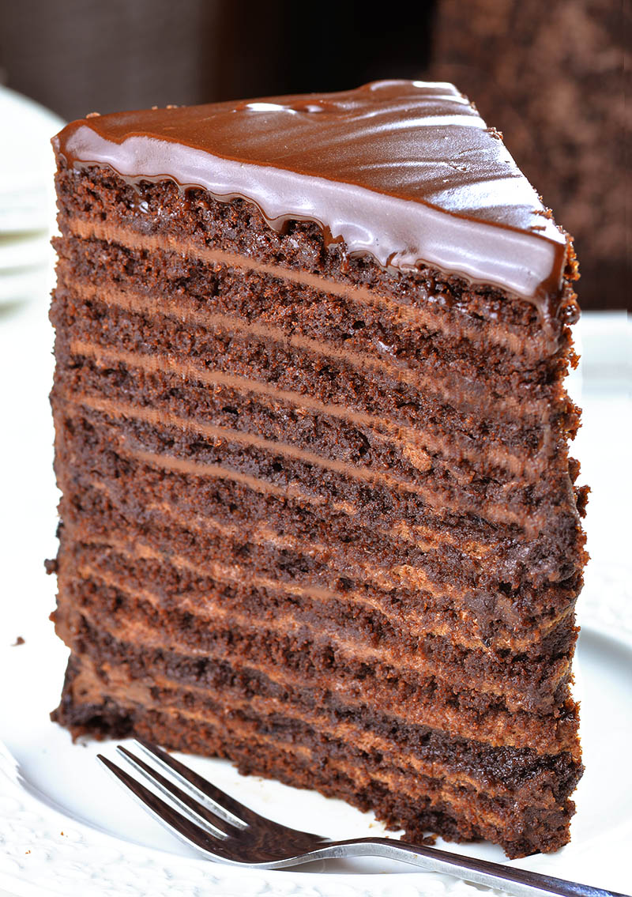
A Grants Program
Strong grant writing is part of a grants program, with many layers of execution, expertise, and institutional buy-in.

Slide 13
What Is a Grant?
An opportunity to bring positive change to an organization
A formal competitive process for a grant maker’s funds
A contract to carry out specific, agreed-upon work
A public relations tool to improve visibility and reputation
A revenue stream that is variable
but important

Slide 14
Grant Obligations
In addition to their benefits, grants result in:
More work for staff, often above and beyond normal responsibilities
Obligations to fulfill specified programmatic goals and objectives
Additional requirements for accounting, reporting, & public relations

Slide 15
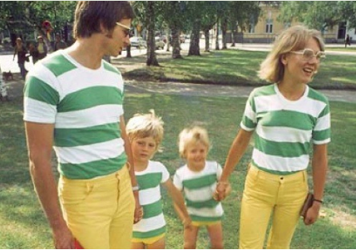
Grant Obligations
There is often a commitment
to provide a funding match.

Slide 16
Tips for Grant Writing Success
#1 – Ensure your proposal aligns with the goals, needs, and interests of the funder.

Slide 17
Tips for Grant Writing Success
#2 – Read the fine print VERY CAREFULLY.
No skimming!

Slide 18
Tips for Grant Writing Success
#3 – Make sure any registrations are up to date.
grants.gov
grantsgateway
SAM
DUNS
NIH SBIR/STTR

Slide 19
Tips for Grant Writing Success
#4 – Seek funding for things you already intend to do.
Don’t chase the money.
Notes:
can add work and expenses. a grant never covers all the expenses needed to run a program;

Slide 20
Tips for Grant Writing Success
#5 – Convince the funder that you know what you’re doing.

Slide 21
Tips for Grant Writing Success
#6 – Make sure the narrative and the budget match.

Slide 22
Tips for Grant Writing Success
#7 – Remember that funders are people – trying reaching out via email or phone too.

Slide 23
Tips for Grant Writing Success
#8 – Be careful what you wish for...you just might win the grant.

Slide 24
Tips for Grant Writing Success
#9 – Public relations and outreach are critical. Keep your PR in good order.
Notes:
make sure website reflects what you are saying in a grant. capital campaigns

Slide 25
Burning Questions
What is the optimal way to reach foundations that do not accept unsolicited proposals?
How to get larger arts grants?
How can small orgs compete against the "big dogs" for grant funding?
What is "secret" to being awarded a grant: specific language, data, etc.?
What is the best way to leverage funding to appeal to potential or new funders?
Where to find funding opportunities for X? (food pantries, musicians, historical societies, infrastructure, capital projects, programs, etc.)
Where do I start???

Slide 26
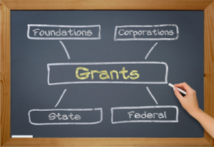
Searching for Grants
Searching For Grants:
Foundation Directory Online (fconline.foundationcenter.org/)
Grants Action News (assembly.state.ny.us/gan/)
Grantstation.com
Grants.gov
Grantsreform.ny.gov
Grantwatch.com
Other Sources:
Relevant agencies (e.g. DEC for environmental orgs)
Professional assns (e.g. Grant Professionals of Lower Hudson)
Local economic development organizations

Slide 27
Thank You
Up Next:
Auditorium: Meet the Funders
Room 101: Funding Your Municipal Infrastructure Project
Room 102: Don’t Leave Money on the Table: Exploring IDA Tax Exemptions
*Slides will be available after the
conference at choicewordspr.com*

