Slide 1
Nobody Puts the Grant Writer in the corner
Best Practices and Helpful insights
Lydia S. Howie, MS, GPC, Founding President
Grant Professionals of Lower Hudson

Slide 2
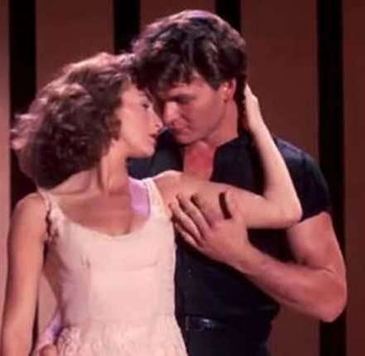
Nobody Puts Baby in the corner

Slide 3
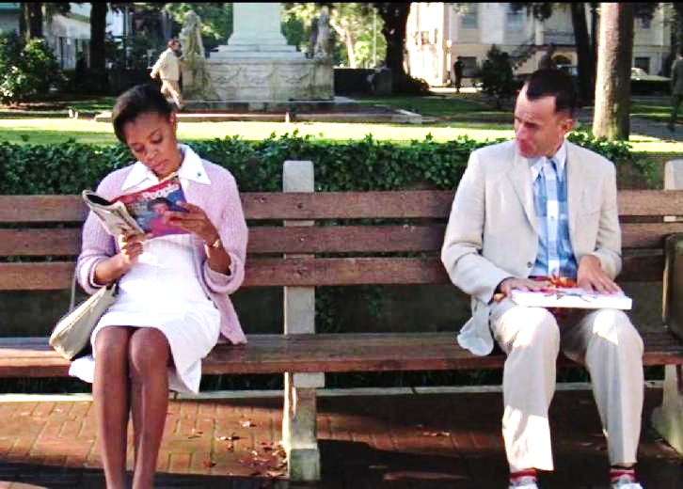
Mama always said life was like a box of chocolates. You never know what you're gonna get.
Lydia S. Howie, MS, GPC, Founding President
Grant Professionals of Lower Hudson

Slide 4
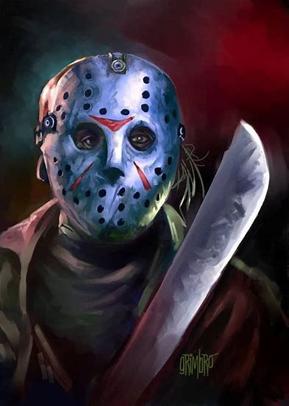
Grant writing nightmares

Slide 5
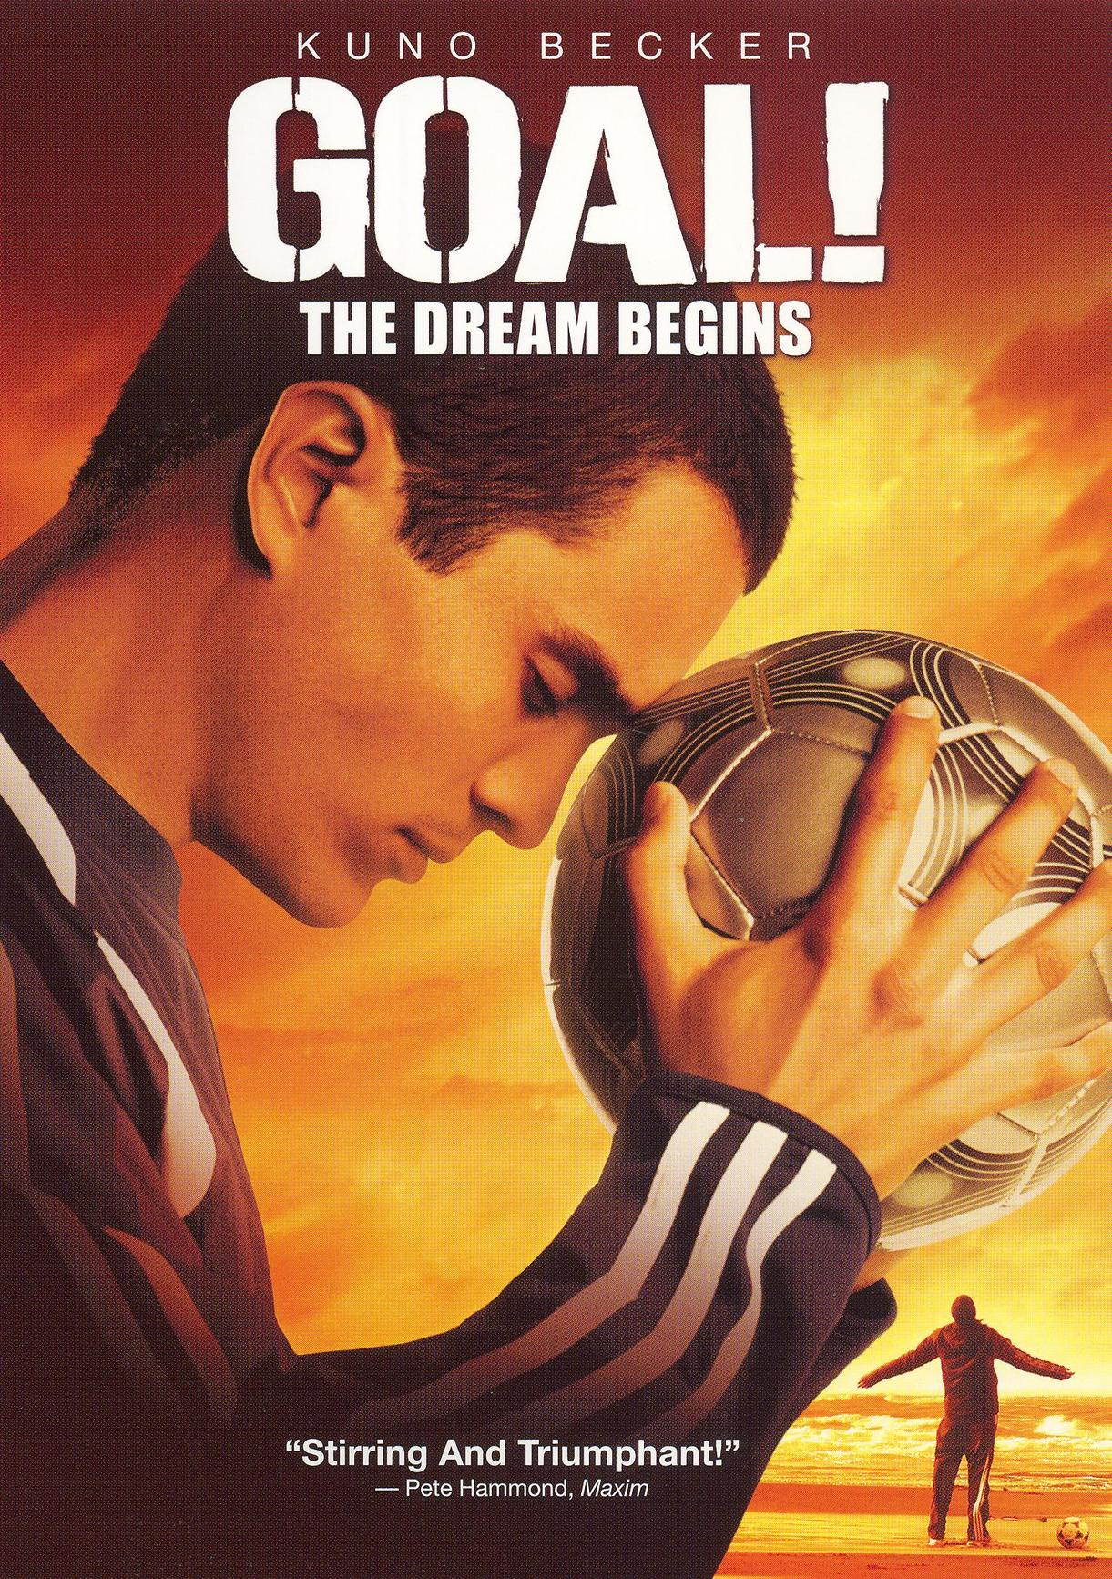
Workshop goals • To present some best practices and systems that will help you avoid grant writing nightmares (e.g. missing reports, missing renewals, angry funders) • To improve better department functioning / client relationships.

Slide 6
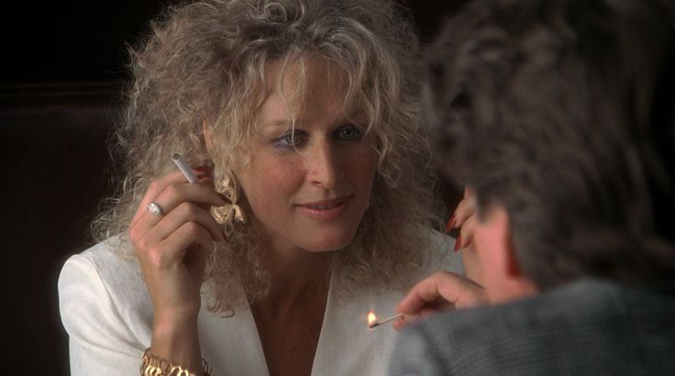
I won’t be ignored, Dan

Slide 7
Grant writers need to be part of the development team
- Grant writer must be included in staff meetings (or invited to occasional staff meetings).
- Make sure they get e-newsletters, annual reports, new brochures/ literature, department annual reports, and press releases.
- CC or BCC them on important staff correspondence.

Slide 8
regularly scheduled grants meetings with your in-house grant writer or consultant – In person or by phone every 3-4 weeks
- Keeps them abreast of agency happenings, awards/achievements, grant awards, personnel changes, etc.
- Keeps them informed of major agency changes (Is there a geographic area that you are no longer serving? New partners or partners that you are no longer working with? Is there a merger pending? Is the agency physically moving?)
- Able to get agreement on next round of grants, discuss renewals, etc.

Slide 9
Build a culture in your organization of the importance of grant writing
- Explain to program staff the importance of grant writing (e.g. keeps their jobs, brings in extra money for their departments).
- Remind program staff that they need to respond quickly to the grant writer’s request for info.

Slide 10
The grant writer should have direct contact with staff
- To obtain program details, objectives, outcomes, etc.
- To access specialized data relating to the grant request (e.g. # served in a geographic area, % by race, % with disabilities).
- To obtain results.
- To obtain list of needs and wants.

Slide 11
Have grant writer engage with staff leadership
Attend a senior staff meeting to develop a good working relationship with CEO, CFO, COO, etc.
Learn agency vision, strategic focus, etc. – get copy of agency business plan.

Slide 12
Have grant writer engage with board leadership
Attend a board meeting to develop a good working relationship.
Obtain their involvement (e.g. potential leads, news of other awarded grants, their potential funder contacts).
Determine if they have connections with board members of prospective funders.
Tell them of grant awards so they can thank the funder, promote the award to other potential donors, etc.

Slide 13
Strongly suggest a quarterly meeting with finance
- Learn what grants have come in.
- Prevent miscoding of grants.
- Tricky proposals with specific budget questions are best left to Finance to create/answer.
- Funders want to know supporters during previous fiscal or grants committed/pending.
- Learn problems they are having with budgets created by Development.
- Develop rapport so have better working relationship with them.

Slide 14
Engage with communications personnel
To ensure that awards and funders are recognized - Very often grant recaps ask for samples of publicity.
Best source to learn news such as board or leadership changes, recent achievements, new program components, etc. from them.

Slide 15
Include grant writer in funder correspondence and invite grant writer to funder meetings
- Grant writers have intimate knowledge of program.
- Grant writers can “talk” the language of funders.
- Gives the funder a back-up person to reach.
- Second person to ensure proper stewardship occurs.

Slide 16
Grant writer should manage the agency’s grants chart
- Accurate record all kept in one place.
- Prevents missing renewals.
- Ensures timely reporting.

Slide 17
Grant writer does all submissions
- Ensures that deadline will not be missed.
- Ensures that submission is packaged correctly, including all addendums created/enclosed.
- Ensures that submission is “logged” in on the master grants chart.

Slide 18
Grant writers should prepare reports
- They know the format that needs to be completed (e.g. online, WORD doc).
- Ensures that promised outcomes are reported on.
- They know the funder and what they want their money to achieve.

Slide 19
Grant writer should “prepare” Executive Director
- Supply verbal bullet points or handouts for funder site visits.
- Write speech for funder presentation.

Slide 20
May the force be with you

Slide 21
Importance of education and credentialing (e.g. GPLH membership, GPA membership, national GPA conference, Grant Professional Certification Institute, local college courses, grant writing conferences)
- Learn best practices and stay on top of your game.
- Build your “cred” – credibility, credentials, status.

Slide 22
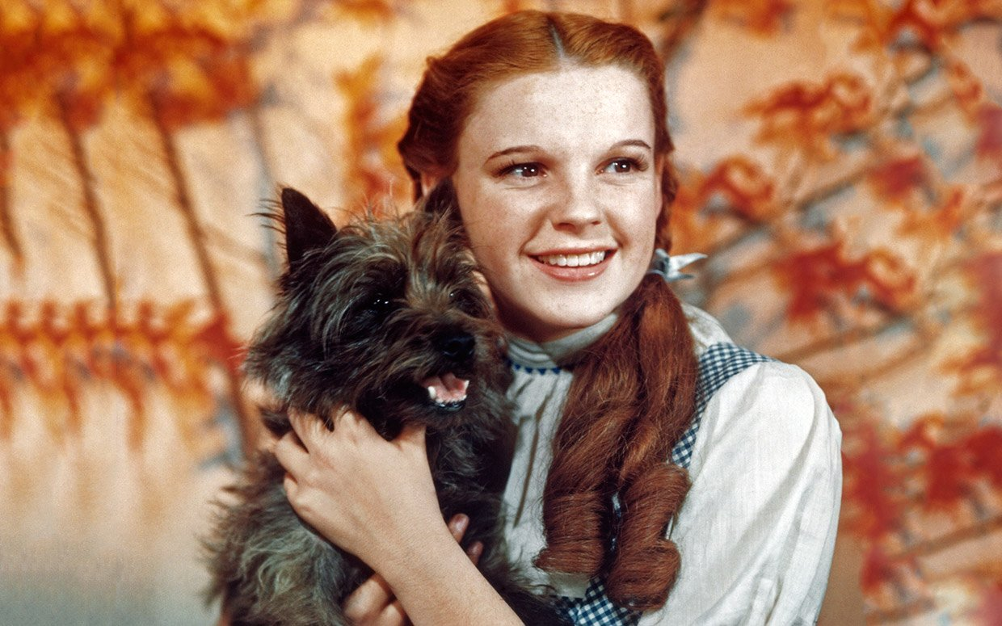
Toto, I’ve a feeling we’re not in Kansas anymore. We must be over the rainbow!

Slide 23
What you can expect if you “Have a seat at the table”
Submissions are accurately submitted
Never missing a deadline
No miscoding and less budget issues
Grants will be more robust because of the knowledge you have
Better rapport with funders
You will have more funding leads
EDs are better able to “sell” the program to funders
Reports will be done adequately, helping to maintain renewal money
Increased likelihood of being funded and maintaining funding

Slide 24
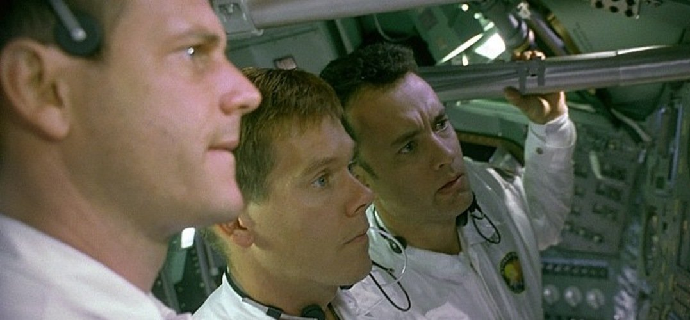
Houston, we have a problem

Slide 25
How to address not being given a seat at the table
- Need to discuss with ED or DD the importance of having a seat at the table -- present the good business reasons why the grant writer needs to be involved/kept informed.
- Tell him/her you will CC him/her on all correspondence.
- Just schedule regular meetings.
- If consultant, place requirement in your contracts.

Slide 26
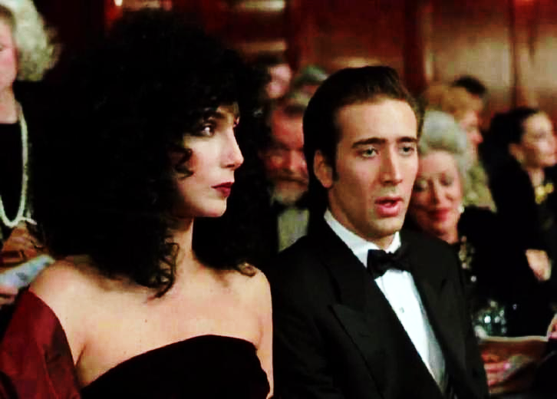
Snap out of it!

Slide 27
Introvert vs Extrovert
- Gladys Grant Writer – More solitary; likes to work by themselves; enjoys researching more than writing; would prefer not to speak with staff; hates to call funders – Likes to be in the corner
- Gabby Grant Writer – Outgoing; enjoys contact with agency staff; wants to be part of the team; enjoys speaking with funders/ making relationships – No one puts her in the corner

Slide 28
Listen to them. Children of the Night. What music they make.

Slide 29
Benefits of working with a consultant
- In addition to:
Only pay for the work that you need.
No benefits, FICA or taxes. Don’t need space for hm or her.
Generally get a very experienced grant writer who can research/recommend prospective funders,
- Consultant grant writers have the advantage of:
Respected more for their expertise – Very often turned to for grant writing guidance and advice on funder relationship building.
Can make it part of their contract that will have staff/board contact.

Slide 30
Consultant restrictions/Issues Getting a seat at the table
- Consultants set own schedules and are free from supervision/control (Can’t demand they work on site. Can’t demand their attendance at staff meetings.)
- Some staff people don’t respect consultants as much as a staff member.
- Some staff are slower to respond to requests from consultants.

Slide 31
Carpe diem. Seize the day, boys. Make your lives extraordinary.
Lydia S. Howie, MS, GPC
Howiemarketing1@gmail.com or 410-275-4457

